Slide 1
STATISTICS I
Prof. Dr. Raziye Selim
(Exploratory Data Analysis-Cases)

Slide 2
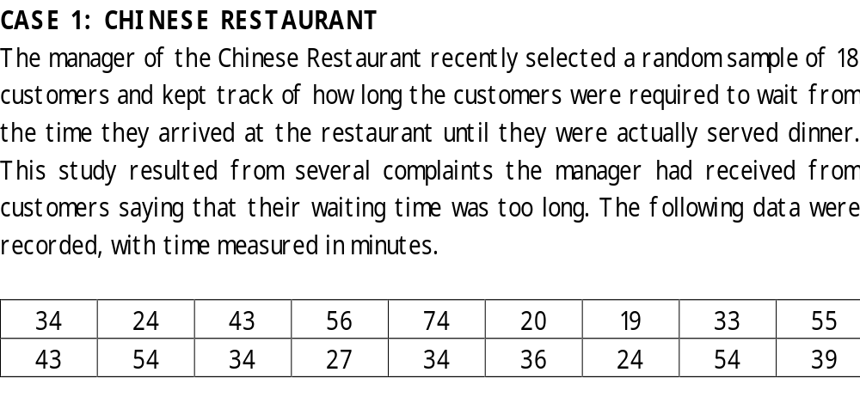
Chap 3-<number>
© 2002 Prentice-Hall, Inc.

Slide 3
Draw a stem-and-leaf graph.
Compute the median waiting time for this sample of customers.
Compute the 5 summary measures and draw box-and-plot graph. Discuss the shape of the distribution.
The manager is considering giving a complimentary drink to customers whose waiting time is longer than the third quartile. Determine the minimum number of minutes a customer would have to wait in order to receive a complimentary drink.
Chap 3-<number>
© 2002 Prentice-Hall, Inc.

Slide 4
Chap 3-<number>
© 2002 Prentice-Hall, Inc.

Slide 5
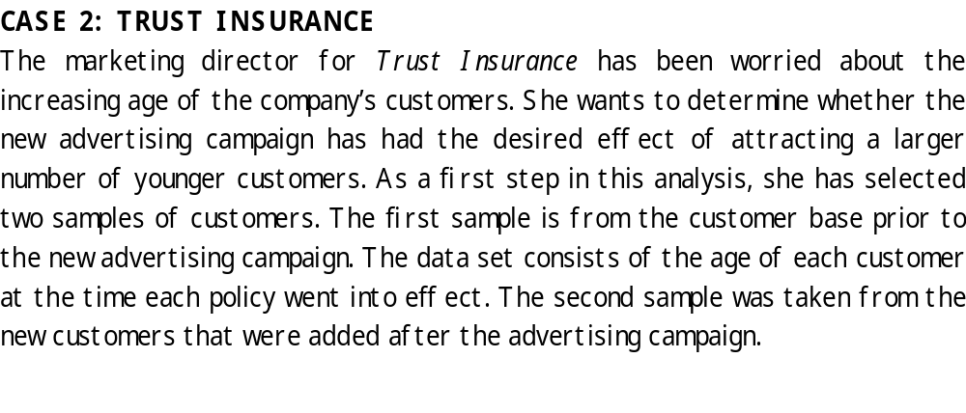
Chap 3-<number>
© 2002 Prentice-Hall, Inc.

Slide 6
Pre-advertising | Post-advertising
33 | 23
44 | 31
52 | 40
34 | 28
25 | 26
30 | 34
40 | 40
29 | 28
55 | 25
36 | 29
Chap 3-<number>
© 2002 Prentice-Hall, Inc.

Slide 7
Draw stem-and-leaf graph and compute 5 summary measures for pre-advertising and post-advertising.
Draw box-and-plot.
Compare the distributions with respect to -level, -variation, -skewness, and –outliers.
Is there any indication from these two samples that the new customers may tend to be younger?
Chap 3-<number>
© 2002 Prentice-Hall, Inc.

Slide 8
Chap 3-<number>
© 2002 Prentice-Hall, Inc.

Slide 9
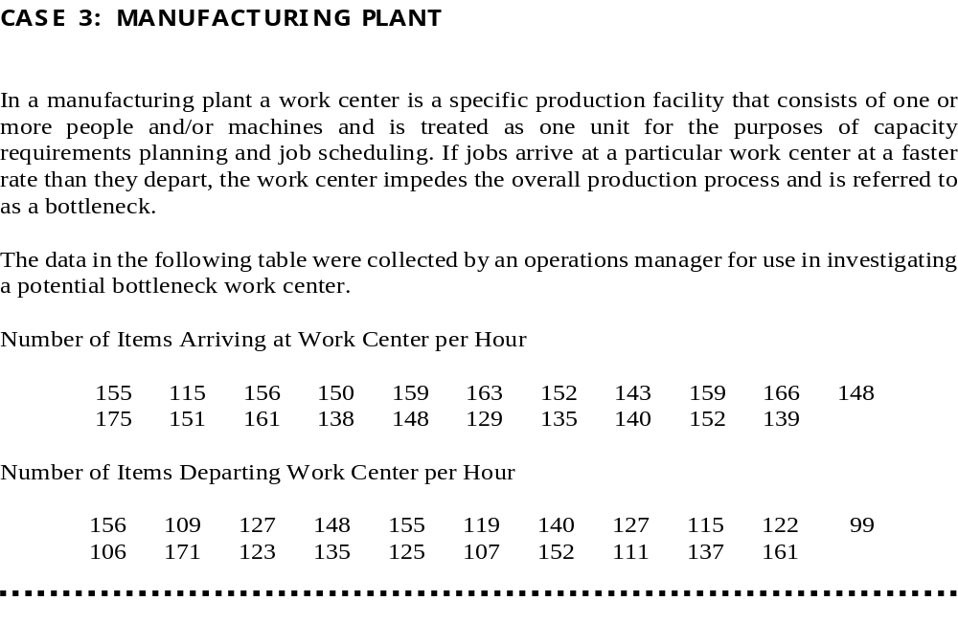
Chap 3-<number>
© 2002 Prentice-Hall, Inc.

Slide 10
Chap 3-<number>
© 2002 Prentice-Hall, Inc.

Slide 11
Draw stem-and-leaf graph and compute 5 summary measures for arriving and departing distributions.
Do the stem and leaf graph suggest that the work center may be bootleneck?
Draw box-and-plot graphs.
Compare the distributions with respect to -level, -variation, -skewness, and –outliers.
Chap 3-<number>
© 2002 Prentice-Hall, Inc.

